Slide 1
Introduction to Data Science
Dr. N. Subhash Chandra
Professor CSE

Slide 2
UNIT-1: Contents
UNIT I – Introduction to Data Science:
Data science, Characteristics of Bigdata, Different steps in Data science process, Types of Data analytics.
Descriptive Analysis: Data Types and Scales, Types of Data Measurement Scales, Measures of Central Tendency, Measures of Variation, Similarity, and dissimilarity measures,
Data preprocessing: Data Cleaning, Data Integration, Data Transformation.

Slide 3
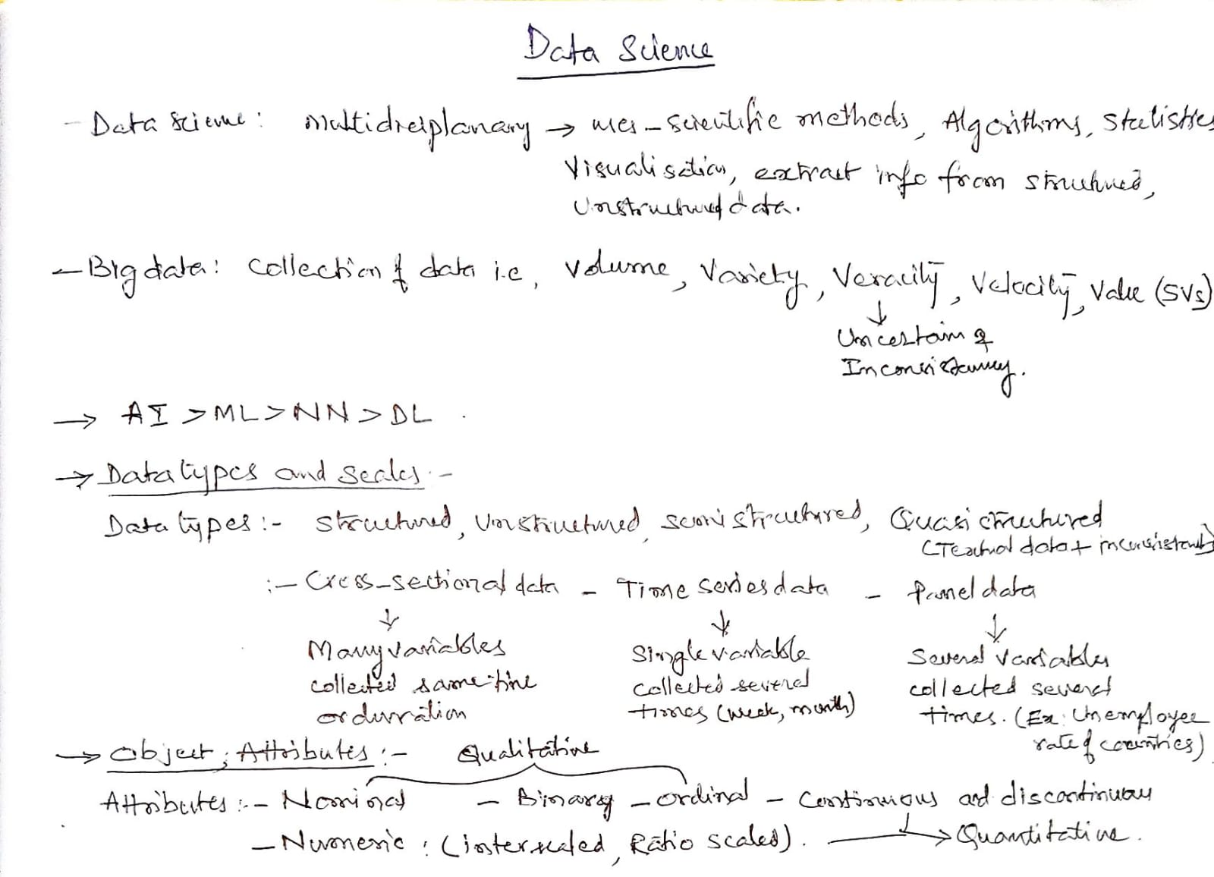

Slide 4
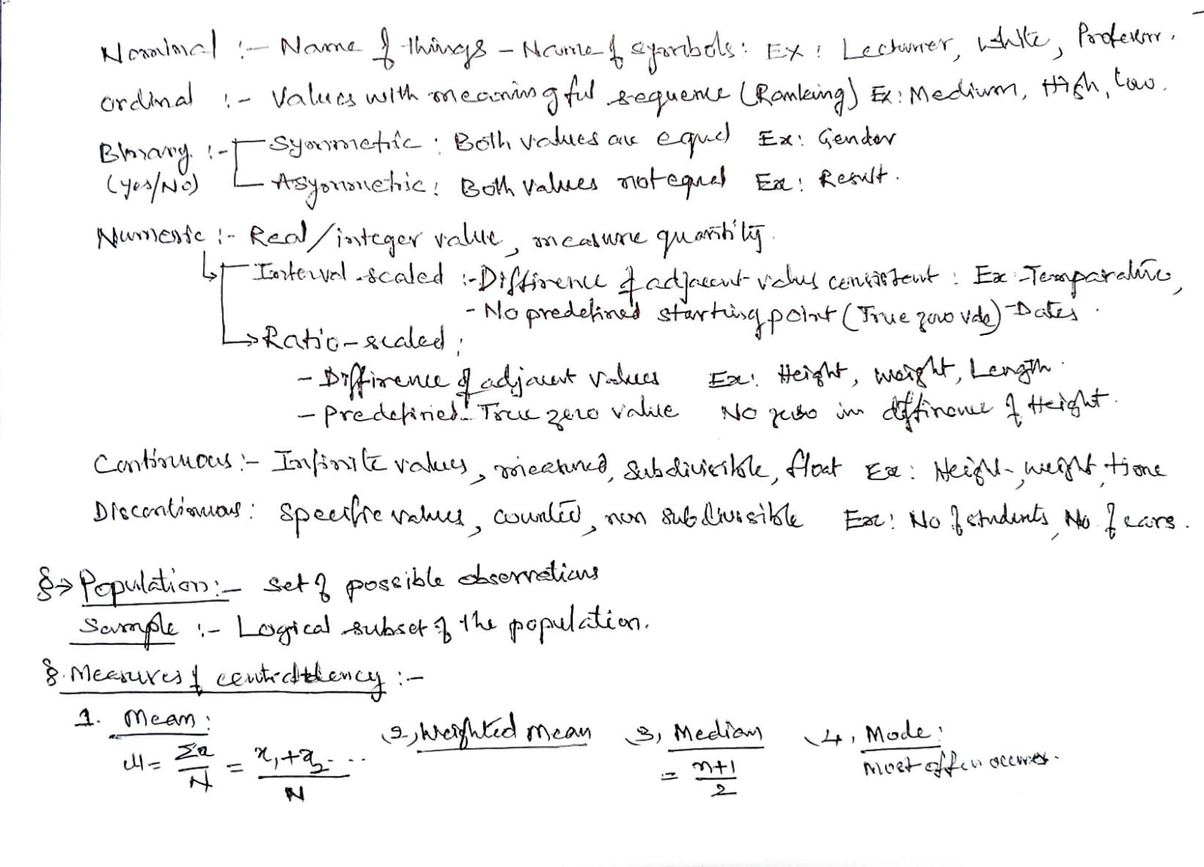

Slide 5
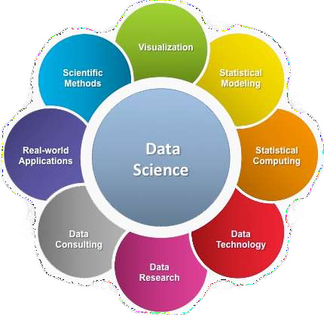
What is Data Science?
A multi-disciplinary field that uses scientific methods, processes, algorithms and systems to extract knowledge and insights from structured and unstructured data.

Slide 6
Advantages and Disadvantages of Data Science
Advantages
Insightful historical data analysis
Better business decisions
Product development & marketing
Personalized recommendations
Disadvantages
Privacy concerns
Misuse of customer data
Profiling risks
Ethical implications

Slide 7
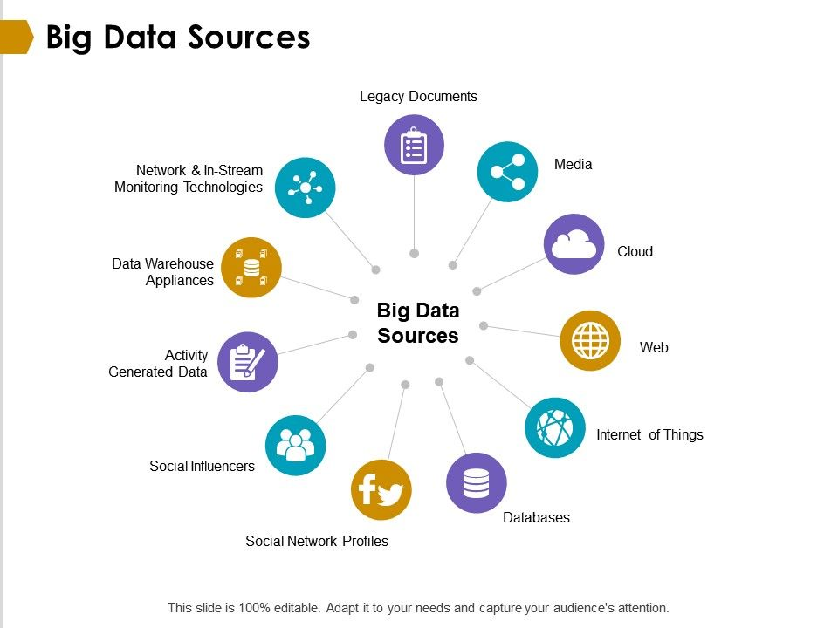
What is BIG DATA?
Big Data is a collection of data that is huge in volume, Complex, yet growing exponentially with time.
It can not be handled by traditional data management tools can store it or process it efficiently.
Ex: Social media, sensors, logs

Slide 8
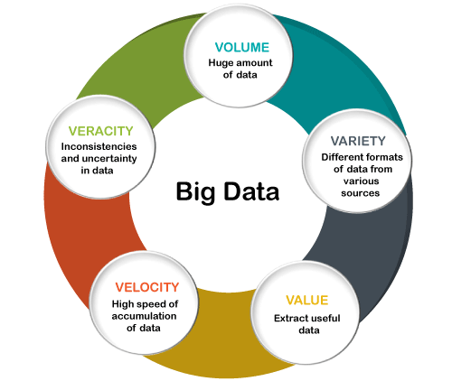
Traits/Characteristics Of Big Data
There are five v's of Big Data that explains the characteristics.
5 V's of Big Data
  Volume
  Variety
  Veracity
  Velocity
  Value

Slide 9
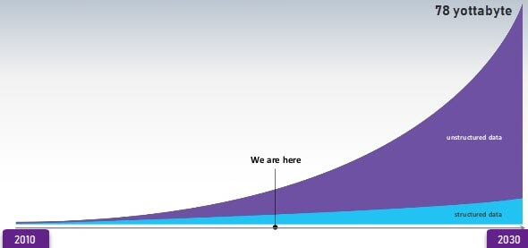
Volume:
The name Big Data itself is related to an enormous size. Big Data is a vast 'volumes' of data generated from many sources daily, such as business processes, machines, social media platforms, networks, human interactions, and many more.
Facebook can generate approximately a billion messages, 4.5 billion times that the "Like" button is recorded, and more than 350 million new posts are uploaded each day. Big data technologies can handle large amounts of data.
DATA GROWTH

Slide 10
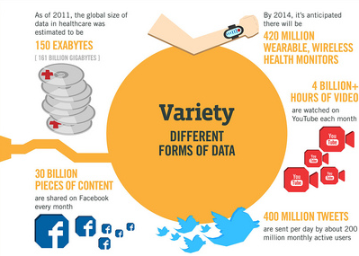
Variety:
Big Data can be structured, unstructured, and semi-structured that are being collected from different sources.
in the past, data is only be collected from databases and sheets
But these days the data will comes in array forms, that are PDFs, Emails, audios, SM posts, photos, videos, etc.

Slide 11
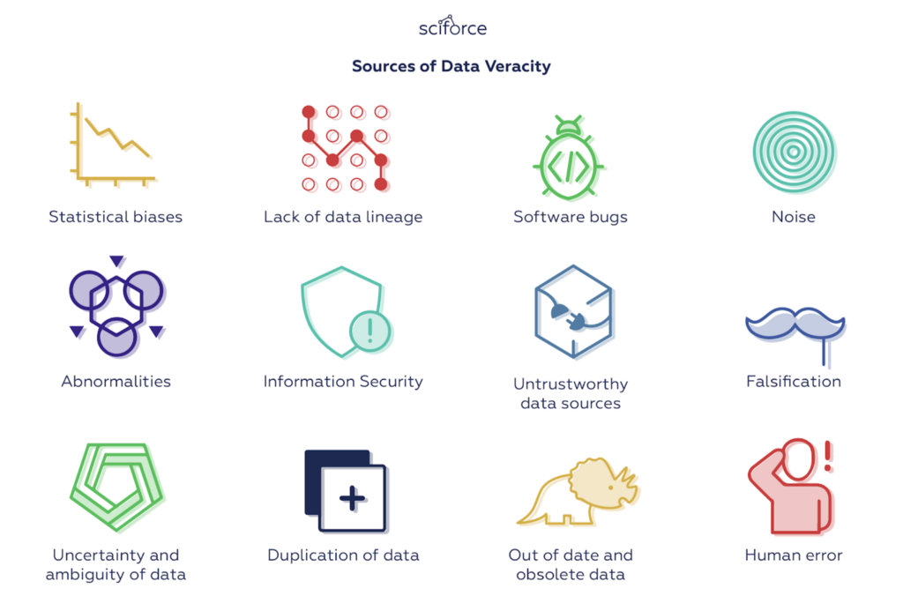
Veracity:
Veracity means how much the data is reliable.
Big Data Veracity refers to the biases, noise and abnormality in data.
Is the data that is being stored, and mined meaningful to the problem being analyzed.
veracity in data analysis is the biggest challenge when compares to things like volume and velocity.

Slide 12
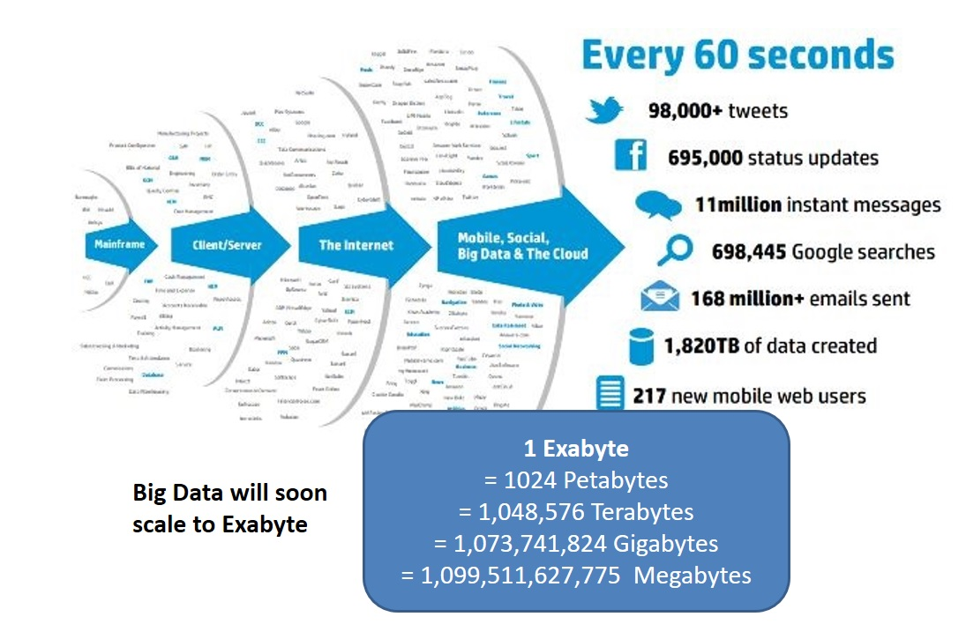
Velocity and value:
Velocity – The term 'velocity' refers to the speed of generation of data. How fast the data is generated and processed to meet the demands, determines real potential in the data.
Big Data Velocity deals with the speed at which data flows in from sources like business processes, application logs, networks, and social media sites, sensors, mobile devices, etc.
The flow of data is massive and continuous.
Value- sits at the top of the big data pyramid.
This refers to the ability to transform a tsunami of data into business.
it is not the data that we process or store.
It is valuable and reliable data that we store, process, and also analyze.

Slide 13
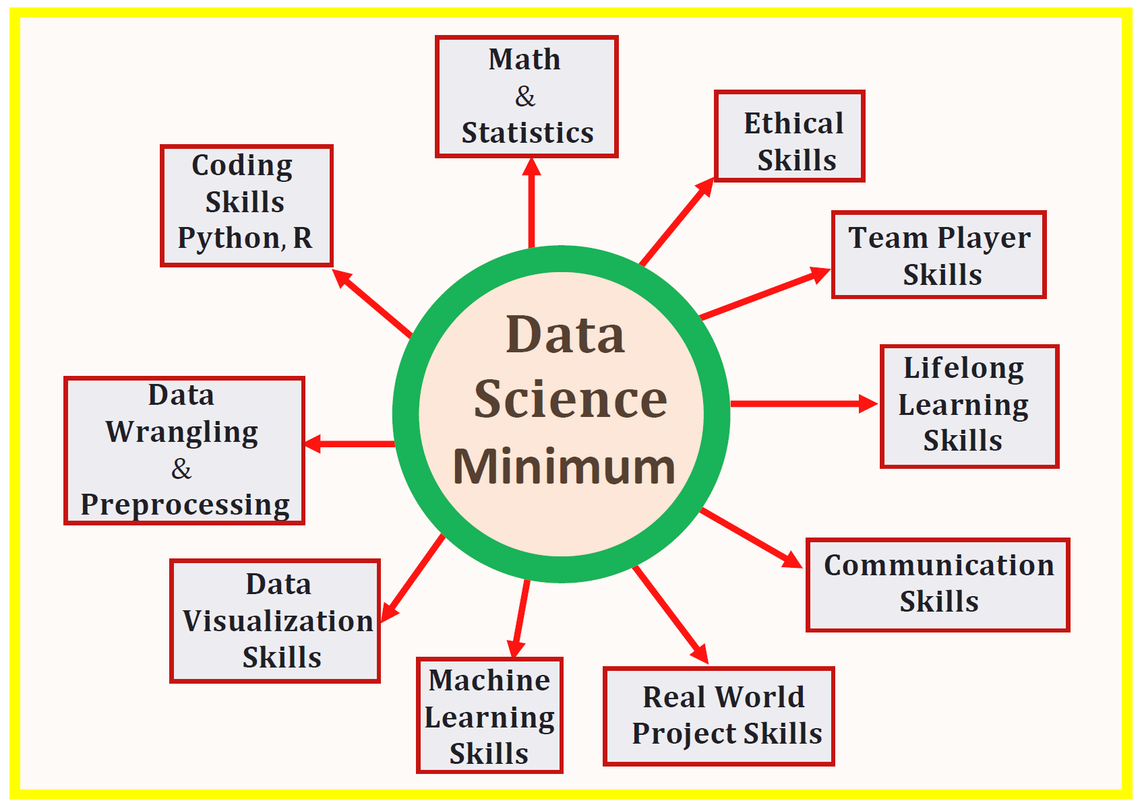
Data Science requirements:

Slide 14
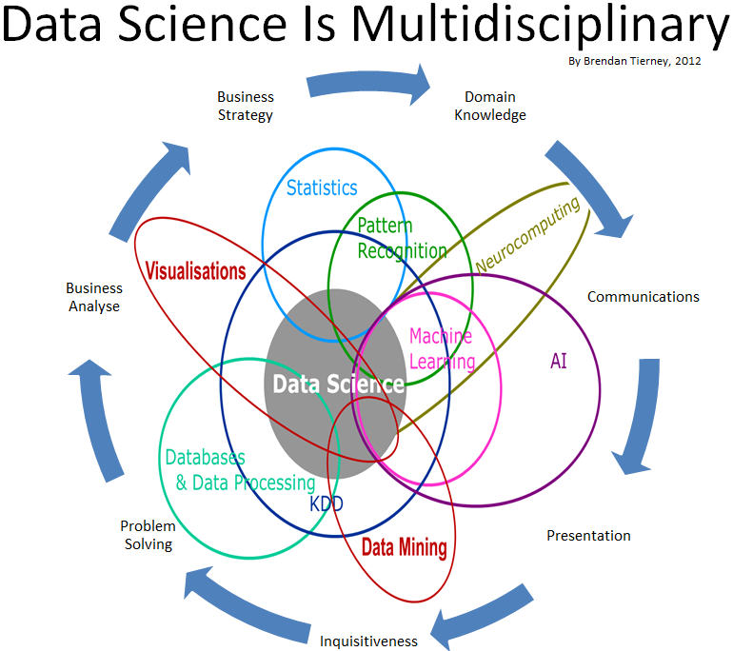
Data Science

Slide 15
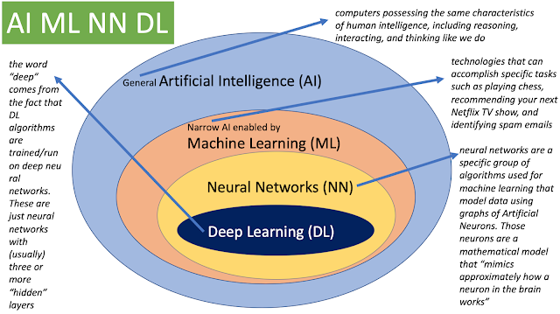

Slide 16
Steps in Data Science Process- six steps
Setting research goal
Retrieving data
Data Preparation
Data Exploration
Data Modelling
Presentation and Automation

Slide 17
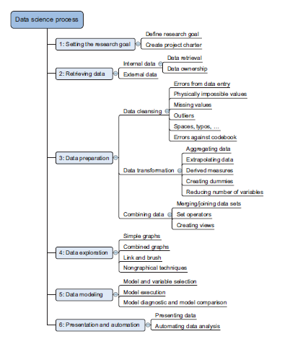
Steps in Data Science Process- six steps

Slide 18
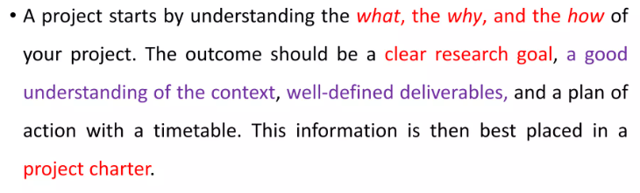
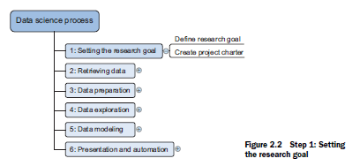

Step 1: Defining Research goal and creating project Charter

Slide 19
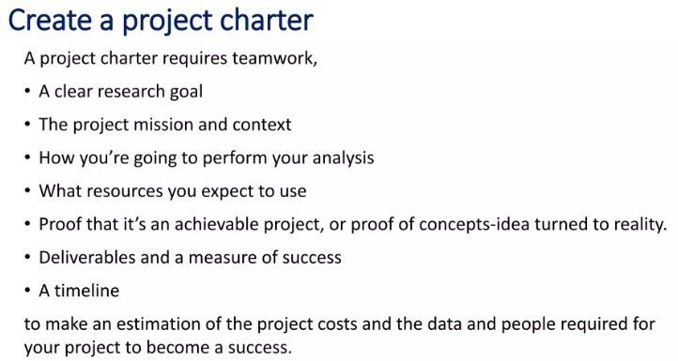
Step 1: Defining Research goal and creating project Charter

Slide 20
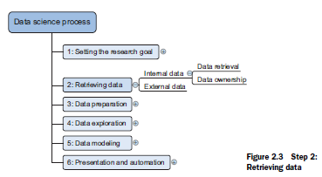
Step 2- Retrieving data
Data can be stored in many forms, ranging from simple text files to tables in a database.
The objective now is acquiring all the data you need. This may be difficult, and even if you succeed, data is often like a diamond in the rough: it needs polishing to be of any use to you.

Slide 21
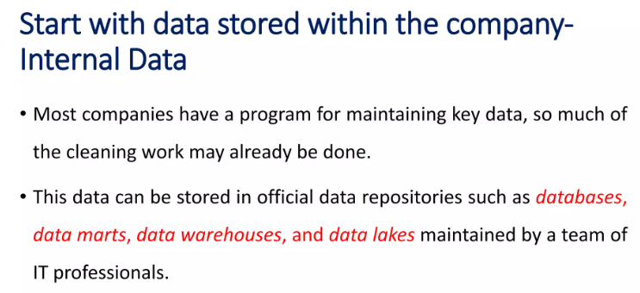

Slide 22
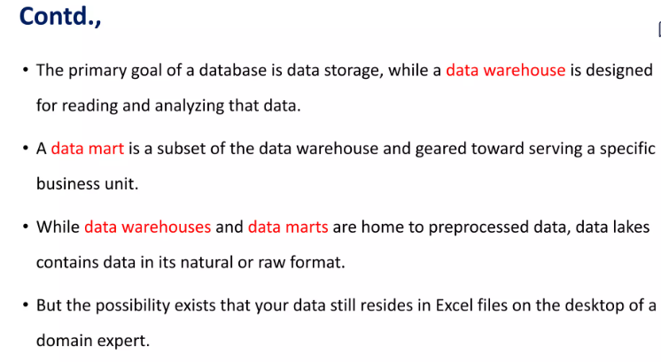

Slide 23
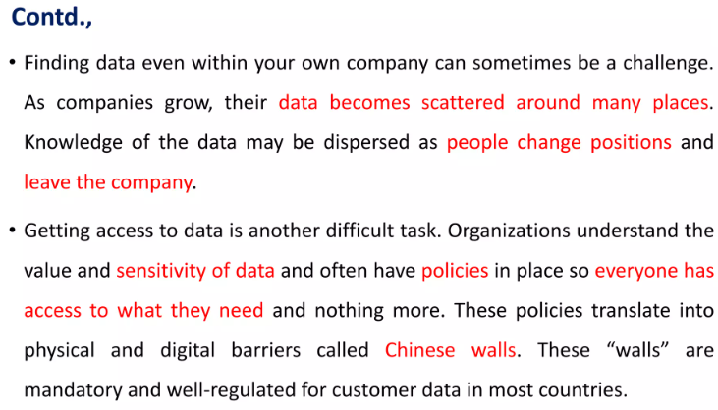

Slide 24
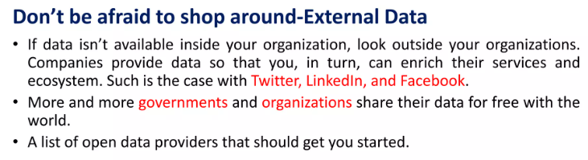
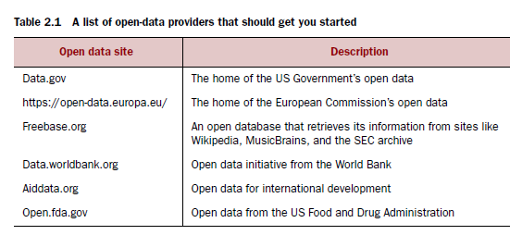

Slide 25
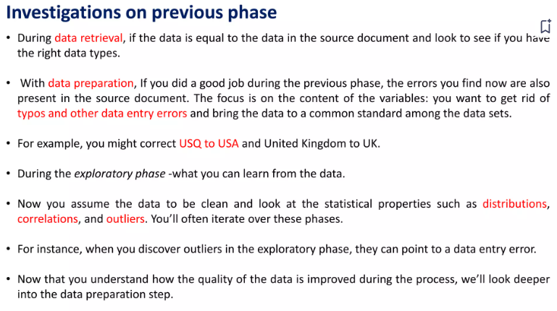

Slide 26
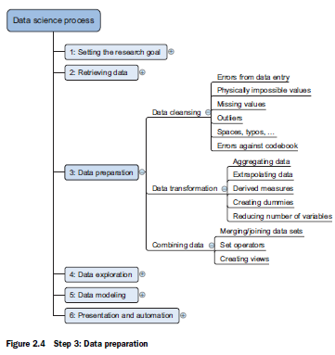
Step 3: Data Preparation: Cleansing, integrating, and transforming data
The data received from the data retrieval phase is likely to be “a diamond in the rough.” Your task now is to sanitize and prepare it for use in the modelling and reporting phase.

Slide 27
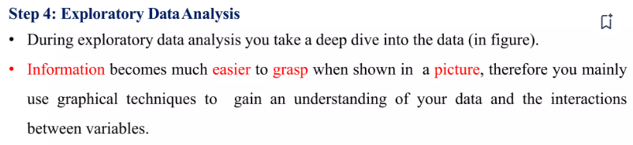
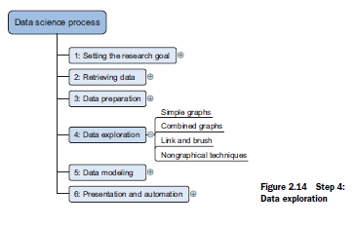
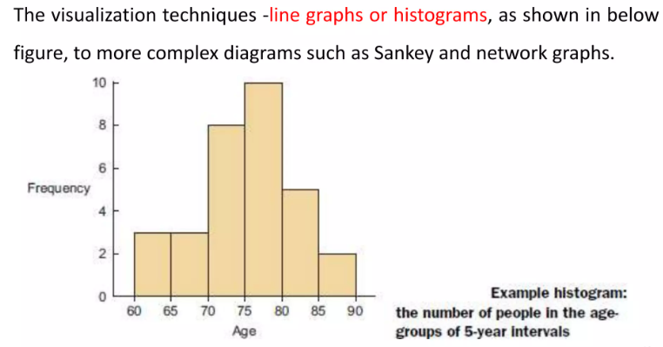
Step 4-Data exploration

Slide 28
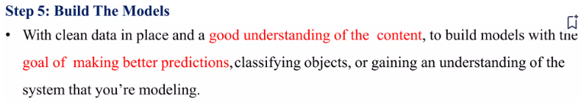
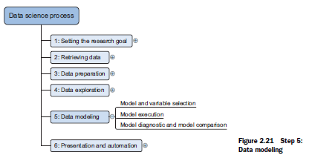
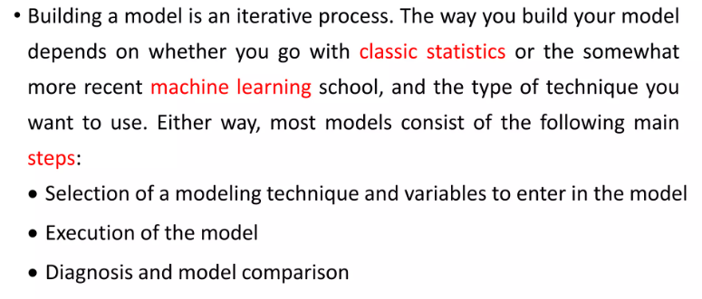
Step 5-Data modeling

Slide 29
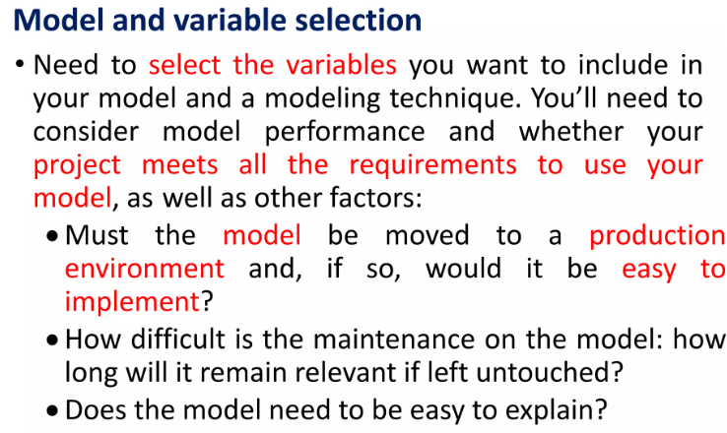
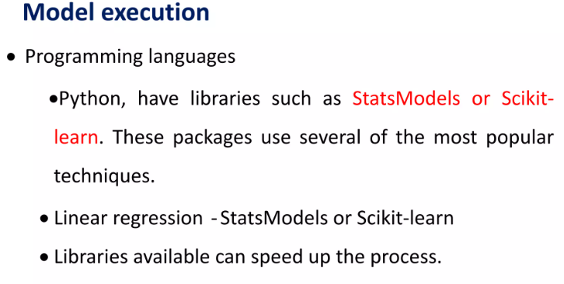
Step 5-Data modelling

Slide 30
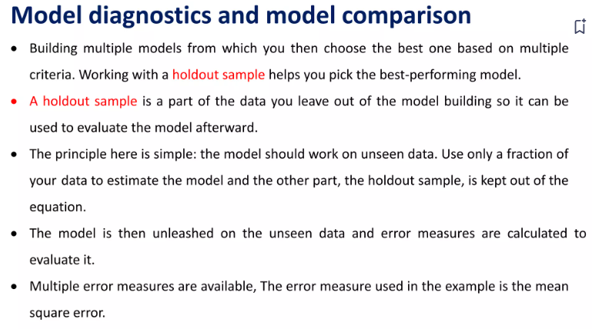
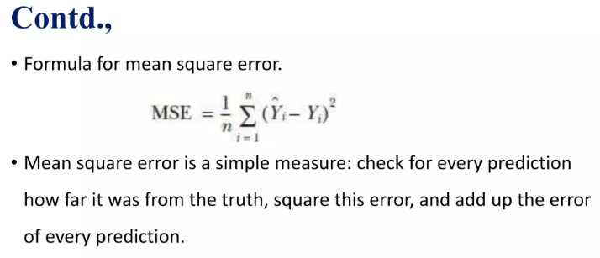
Step 5-Data Modelling

Slide 31
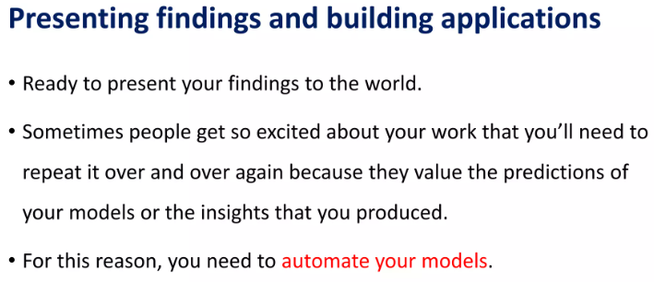
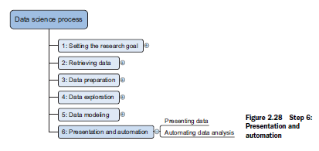
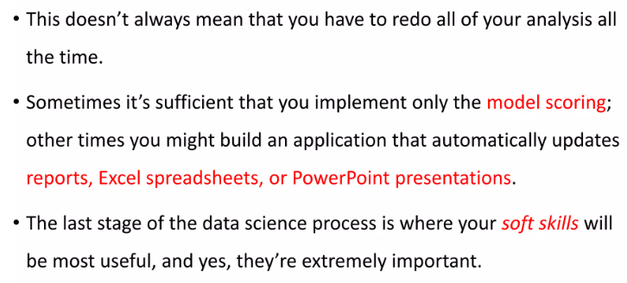
Step 6-Presentation and automation

Slide 32
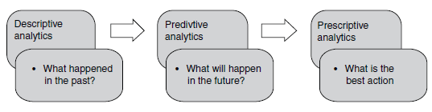
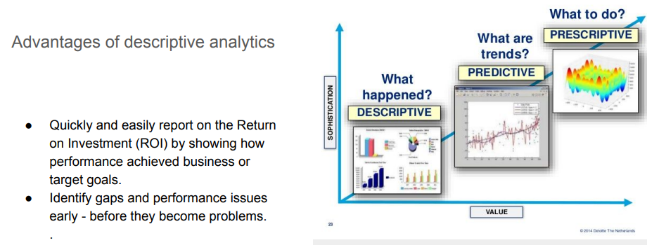
Types of data Analytics-DESCRIPTIVE ANALYTICS
Types:
Descriptive analytics: Summarise past data Ex: Reports, Dashboards
Predictive analytics: Forecast future outcomes Ex : sales
3. Prescriptive analytics:Ex. Recommandations

Slide 33
Types of data Analytics-PREDICTIVE ANALYTICS
It aims to predict the probability of occurrence of a future event such as forecasting demand for products/services, customer churn, employee attrition, loan defaults, fraudulent transactions, insurance claim, and stock market fluctuations.
predictive analytics is used for predicting what is likely to happen in the future.

Slide 34
Types of data Analytics- PRESCRIPTIVE ANALYTICS
Prescriptive analytics is the highest level of analytics capability which is used for choosing optimal actions once an organization gains insights through descriptive and predictive analytics.
In many cases, prescriptive analytics is solved as a separate optimization problem. Prescriptive analytics assists users in finding the optimal solution to a problem or in making the right choice/decision among several alternatives.
Operations Research (OR) techniques form the core of prescriptive analytics. Apart from operations research techniques, machine learning algorithms, metaheuristics, and advanced statistical models are used in prescriptive analytics.

Slide 35
Types of data Analytics-Tools
Predictive analytics techniques: Regression, logistic regression, classification trees, forecasting, K-nearest neighbours, Markov chains, random forest, boosting, and neural networks.
Prescriptive analytics: are linear programming, integer programming, multi-criteria decision-making models such as goal programming and analytic hierarchy process, combinatorial optimization, non-linear programming, and meta-heuristics.

Slide 36
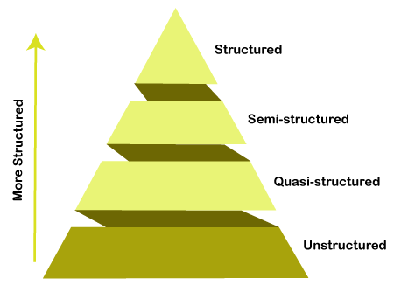
Types Of Big Data:
Structured data: In Structured schema, along with all the required columns. It is in a tabular form. Structured Data is stored in the relational database management system.
Semi-structured: In Semi-structured, the schema is not appropriately defined, e.g., JSON, XML, CSV, TSV, and email. OLTP (Online Transaction Processing) systems are built to work with semi-structured data. It is stored in relations, i.e., tables.
Unstructured Data: All the unstructured files, log files, audio files, and image files are included in the unstructured data. Some organizations have much data available, but they did not know how to derive the value of data since the data is raw.
Quasi-structured Data: The data format contains textual data with inconsistent data formats that are formatted with effort and time with some tools.

Slide 37
Data types and scales
Data is classified into different categories based on data structure and scale of measurement of the variables
Structured and Unstructured Data
Structured data: means that the data is described in a matrix form with labelled rows and columns.
Unstructured data : Any data that is not originally in the matrix form with rows and columns is an.
For example, e-mails, click streams, textual data, images (photos and images generated by medical devices), log data, and videos. Machine generated data such as images generated by satellite, magnetic resonance imaging (MRI), electrocardiogram (ECG) and thermography are few examples of unstructured data.

Slide 38
Data types and scales
Cross-sectional, Time Series, and Panel Data
The data is categorised into the following three classes:
Cross-Sectional Data: A data collected on many variables of interest at the same time or duration of time is called cross-sectional data.
EX: consider data on movies such as budget, box-office collection, actors,
directors, genre of the movie during year 2017.
Time Series Data: A data collected for a single variable such as demand for smartphones collected over several time intervals (weekly, monthly, etc.) is called a time series data.
Panel Data: Data collected on several variables (multiple dimensions) over several time intervals is called panel data (also known as longitudinal data). Example of a panel data is data collected on variables such as gross domestic product (GDP), Gini index, and unemployment rate for several countries over several years.

Slide 39
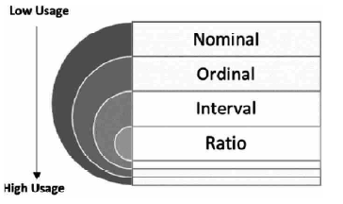
TYPES OF DATA MEASUREMENT SCALES
Structured data can be either numeric or alpha numeric and may follow different scales of measurement (level of measurement).
It is important to understand the type of variables within the data with respect to the measurement scale since the model specification while building analytics models such as regression may depend on the scale of measurement.

Slide 40
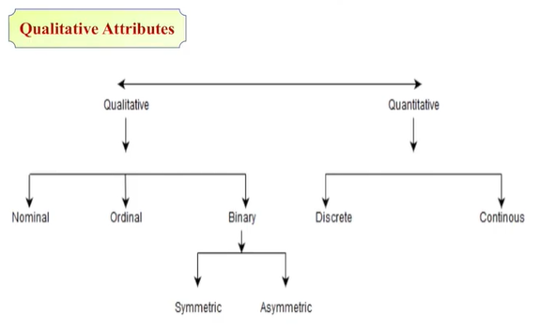
Attributes
Attribute (or dimensions, features, variables): a data field, representing a characteristic or feature of a data object.
  E.g., customer _ID, name, address
Types:
  Nominal
  Binary
  Ordinal
  Continuous and Discontinues
  Numeric: quantitative
    Interval-scaled
    Ratio-scaled

Slide 41
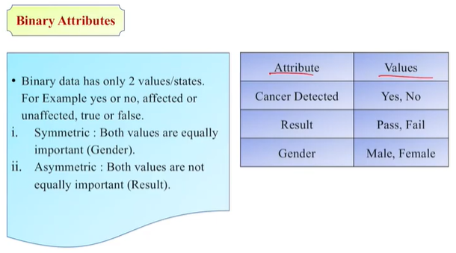
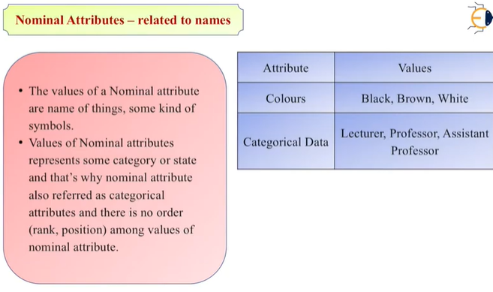
Nominal Attributes-related to names

Slide 42
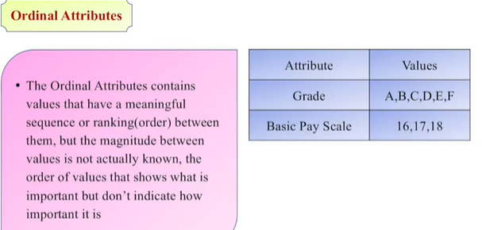

Slide 43
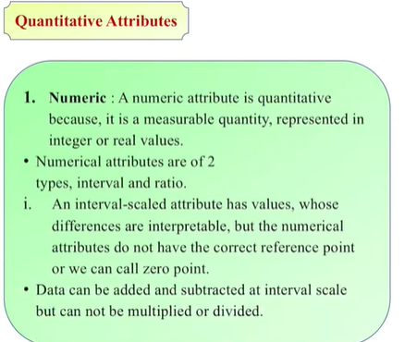
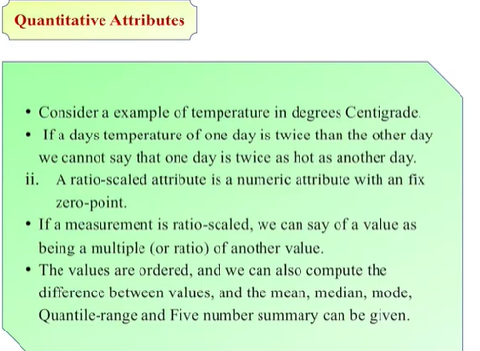

Slide 44
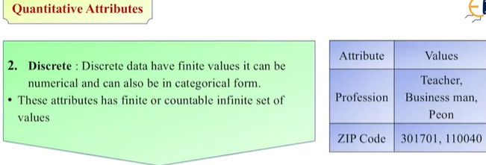
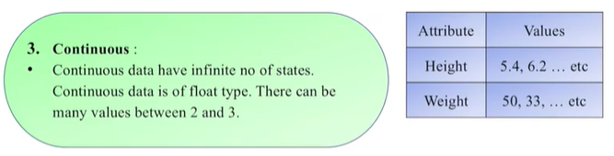

Slide 45
Design the types of attributes involved in CVR CMS?

Slide 46
POPULATION AND SAMPLE
Population: It is the set of all possible observations (often called cases, records, subjects or data points) for a given context of the problem. The size of the population can be very large in many cases.
Sample: It is a logical subset of the population, which mimics the population. Selecting a relevant sample out of the population is challenging, but it makes analysis faster, precise, and economical.
There are standard guidelines from statisticians to calculate the relevant sample size, appropriate sampling methodology, and tool to analyze sampled data.

Slide 47
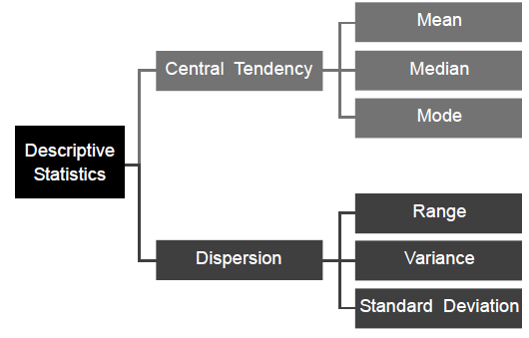
MEASURES OF CENTRAL TENDENCY
Measures of central tendency are the measures that are used for describing the data using a single value. Mean, median and mode are the three measures of central tendency and are frequently used to compare different data sets.
Measures of central tendency help users to summarize and comprehend the data.

Slide 48


MEASURES OF CENTRAL TENDENCY

Slide 49

MEASURES OF CENTRAL TENDENCY

Slide 50



MEASURES OF CENTRAL TENDENCY

Slide 51


MEASURES OF CENTRAL TENDENCY

Slide 52


MEASURES OF VARIATION

Slide 53


MEASURES OF VARIATION

Slide 54



MEASURES OF VARIATION

Slide 55

MEASURES OF VARIATION

Slide 56


